Slide 1
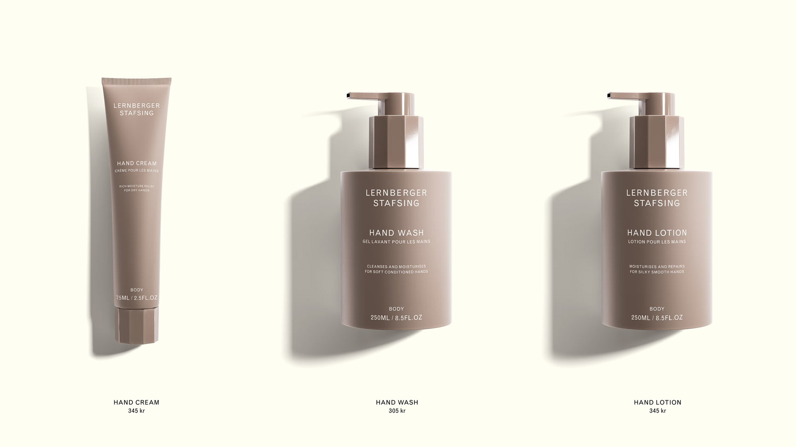
MIPARA.MA
Morocco's Digital Health Pioneer
Mipara.ma
Morocco's First AI-Enhanced
Online Parapharmacy
Transforming Beauty & Healthcare E-commerce Through Innovation, Authenticity, and Expertise
AI-Powered Diagnostics
100% Authentic Products
Expert Pharmacist Guidance

Slide 2
PRESENTATION ROADMAP
Presentation Overview
01
Platform Overview
02
Product Universe
Understanding Mipara's mission, vision, and market positioning as Morocco's pioneering digital health destination
Comprehensive skincare, beauty, and wellness solutions across 8 specialized categories
03
AI Innovation
04
Brand Ecosystem
Revolutionary Para Scan AI technology delivering personalized skin diagnostics in 30 seconds
Trusted partnerships with 15+ world-class dermatological and beauty brands
05
Expertise & Community
06
Customer Experience
Building trust through pharmacist-authored content and engaged customer community
Seamless, secure, and personalized shopping journey with bilingual support
Market Context: Morocco's online pharmacy market valued at $14M (2024), growing 5-10% annually
Global Trend: AI skincare market projected to reach $4.28B by 2035

Slide 3
01
Platform
Overview
Discovering Morocco's pioneering digital health and beauty destination
Where traditional pharmaceutical expertise meets cutting-edge AI innovation to deliver personalized wellness solutions

Slide 4
PLATFORM OVERVIEW
What is Mipara?
Mission & Vision
Market Context
Mipara is Morocco's first AI-enhanced online parapharmacy, revolutionizing how consumers access dermatological and beauty products. The platform combines authentic pharmaceutical expertise with cutting-edge artificial intelligence to deliver personalized wellness solutions.
Morocco Online Pharmacy Market
$14M
2024 market valuation
Annual Growth Rate
5-10%
Projected through 2025
Key Differentiators
Nutrition Category Share
38%
AI Skin Diagnostics
Authenticity Guarantee
Largest market segment
Pharmacist Expertise
Bilingual Platform
Regional Positioning
Innovation Focus: Mipara doesn't just sell products—it delivers personalized dermatological solutions powered by advanced AI technology, setting a new standard for digital health retail in North Africa.
First-mover advantage in AI-enhanced parapharmacy
Bilingual platform serving French & Arabic speakers
Local expertise with international brand partnerships
Cultural alignment with Moroccan wellness preferences

Slide 5
PLATFORM OVERVIEW
Platform at a Glance
8
15+
AI
600
Product Categories
Brand Partners
Skin Diagnostic
MAD Free Shipping
From face to supplements
International dermatological
30-second analysis
Threshold for delivery
Loyalty & Rewards
Customer Support
Trust & Security
Points-based loyalty program
WhatsApp consultation
Secure payment (Visa/MC)
5% first-order discount
Pharmacist expertise
Encrypted transactions
Exclusive member benefits
Personalized assistance
100% authentic products
Mobile-Responsive Design with bilingual interface (French/Arabic)
Order Tracking & history management
Wishlist & favorites functionality

Slide 6
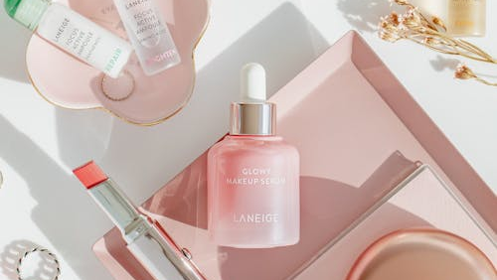
02
Product
Universe
Comprehensive skincare, beauty, and wellness solutions
Eight specialized categories delivering targeted care for every skin concern and beauty need

Slide 7
PRODUCT UNIVERSE
Product Categories
Visage
Corps
Cheveux
Bébé & Maman
Face Care — Complete facial skincare solutions
Body Care — Nourishing body treatments
Hair Care — Solutions for healthy hair
Baby & Mom — Gentle care for families
Shampoos
Conditioners
Cleansers
Moisturizers
Body Lotion
Hand Care
Treatments
Hair Masks
Baby Care
Maternity
Serums
Masks
Shower Gel
Exfoliants
Gentle Formula
Solaire
Compléments
Bio & Naturel
Sun Care — Advanced UV protection
Supplements — Nutritional wellness support
Organic & Natural — Clean beauty selection
Curated Selection
SPF 50+
Face Sunscreen
Every product is pharmacist-approved, ensuring quality and efficacy for your skincare journey
Body Protection
Vitamins
Minerals
Hair/Nails
Organic
Natural
Clean Beauty
Expert Verified
Authentic Only

Slide 8
PRODUCT UNIVERSE
Targeted Skin Concerns
Solution-oriented shopping organized by specific dermatological needs
Acné & Imperfections
Taches & Hyperpigmentation
Anti-âge & Rides
Hydratation & Sécheresse
Solutions for acne-prone skin with purifying and balancing treatments
Brightening products to even skin tone and reduce dark spots
Age-defying treatments to prevent and reduce signs of aging
Deep hydration solutions for dry and dehydrated skin types
Cleansers
Spot Treatment
Vitamin C
Brightening
Retinol
Peptides
Hyaluronic
Moisturizers
Peau Sensible & Atopique
Rougeurs & Rosacée
Pores Dilatés
Chute de Cheveux
Gentle formulations to soothe and strengthen sensitive skin barriers
Calming treatments to reduce redness and inflammation
Pore-refining solutions for smoother, more refined skin texture
Hair strengthening treatments to stimulate growth and reduce loss
Fragrance-Free
Hypoallergenic
Anti-Redness
Soothing
Pore Minimizers
Exfoliants
Growth Serums
Strengthening
Personalized Approach: AI diagnostic matches your concerns to targeted solutions
Expert Curation: All products pharmacist-approved for efficacy

Slide 9
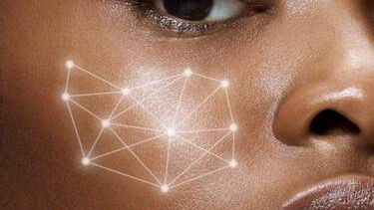
03
AI
Innovation
Revolutionary skin analysis technology
Clinical-grade precision powered by artificial intelligence, delivering personalized skincare in seconds

Slide 10
AI INNOVATION
Para Scan AI: Diagnostic Technology
How It Works
Key Capabilities
Mipara's flagship Para Scan AI uses advanced computer vision and spectral analysis to deliver clinical-grade skin diagnostics in under 30 seconds.
20+ Facial Points Analyzed
Comprehensive skin assessment
<3 Second Processing
Real-time diagnostic results
Technology Stack
98% Accuracy Rate
Validated by dermatologists
1
Computer Vision
Personalized Recommendations
Advanced facial recognition analyzes over 20 distinct facial points
AI-matched product suggestions
2
Spectral Analysis
Detects impurities invisible to naked eye through multi-spectral imaging
Global Market Context
3
AI Algorithms
Machine learning models process data in under 3 seconds
AI Skincare Market 2024
$1.19B
Current global valuation
Projected 2035
$4.28B
12.1% CAGR growth trajectory
Innovation Leadership: Mipara is the first Moroccan platform to bring clinical-grade AI diagnostics to consumers

Slide 11
AI INNOVATION
AI Diagnostic Benefits
Instant Analysis
Clinical Precision
User Journey Flow
No appointments, no waiting. Get professional-grade skin analysis in 30 seconds from anywhere, anytime.
Advanced algorithms deliver accuracy comparable to dermatological assessments, validated by medical professionals.
1
Access Diagnostic Tool
Navigate to AI diagnostic page
2
Position Face in Frame
Camera captures facial image
3
AI Analysis (30 sec)
Personalized Routines
Progress Tracking
Computer vision & algorithms process
AI matches your unique skin profile with targeted products, eliminating guesswork from skincare shopping.
Historical analysis allows you to monitor skin condition changes over time and adjust routines accordingly.
4
Receive Skin Profile
Detailed dermatological assessment
5
Get Product Matches
AI-curated product recommendations
Democratized Access
No Generic Solutions
Brings dermatological expertise to everyone, regardless of location or ability to visit specialists.
Eliminates one-size-fits-all approaches by providing truly customized recommendations based on your skin.
Seamless Integration
AI recommendations directly connect to Mipara's product catalog, enabling one-click shopping for your personalized routine

Slide 12
04
Brand
Ecosystem
Trusted partnerships with world-class dermatological brands
Curated selection of authentic products from 15+ international skincare and beauty leaders

Slide 13
BRAND ECOSYSTEM
Partner Brands Portfolio
Dermatological Leaders
Science-Forward
Internationally recognized brands backed by clinical research and dermatologist recommendations
Evidence-based formulations with active ingredients and transparent science
CeraVe
The Ordinary
Avène
La Roche-Posay
Bioderma
Ceramides
Clinical
Sensitive Skin
Dermatology
Micellar Water
Eucerin
Vichy
SVR
Dry Skin
Mineral-Rich
High-Tech Care
Local Expertise
Moroccan dermatological brands combining local knowledge with modern science
Clean & Natural
DERMADOC
derma
Dermatology
Skincare
Botanical-powered brands focusing on natural ingredients and sustainable beauty
Nuxe
BioOriental
Atlas Nature
Authenticity Promise
French Pharmacy
Natural
Moroccan
Direct Brand Partnerships: All products sourced directly from manufacturers
Pharmacist Curation: Every product vetted by licensed pharmacists
100% Authentic: Zero tolerance for counterfeit products

Slide 14
05
Expertise &
Community
Building trust through knowledge and engagement
Pharmacist-authored content, expert guidance, and an engaged community of skincare enthusiasts

Slide 15
EXPERTISE & COMMUNITY
Expert Content Hub
The Magazine Para.ma
Author Credentials
Mipara's content strategy centers on education and trust-building through expert-authored articles. All content is written by licensed pharmacists and dermatologists, ensuring medical accuracy and practical value.
Licensed Pharmacists
Product expertise & safety
Dermatologists
Clinical skin condition expertise
Content Categories
Medical Review Process
All content medically verified
Routine Guides
Skincare routines tailored to different skin types (oily, dry, combination, sensitive) with step-by-step guidance
Multilingual Content
Example: "Routine Soins Visage : Adaptez-la à Votre Peau"
Dermatology Insights
French — Primary market language
Deep dives into skin conditions, causes, and evidence-based treatment approaches
Arabic — Local market accessibility
Example: "Acné : Comprendre les causes pour mieux la traiter"
Cultural Relevance — Region-specific advice
Wellness & Self-Care
Holistic approaches to beauty including spa rituals, relaxation techniques, and lifestyle tips
Content Impact
Example: "Spa : Le Rituel Ultime pour une Peau Radiante"
Educational content drives product discovery and customer confidence, transforming browsers into informed buyers

Slide 16
EXPERTISE & COMMUNITY
Community & Loyalty
Customer Reviews
Loyalty Program
WhatsApp Support
Authentic customer feedback builds trust and helps shoppers make informed decisions
Rewarding customer loyalty with exclusive benefits and personalized offers
Personalized assistance through Morocco's most popular messaging platform
Product ratings & reviews
Points-based rewards system
Direct pharmacist consultation
Verified purchase badges
Exclusive member discounts
Product recommendations
Detailed user experiences
Early access to promotions
Order & delivery support
Birthday special offers
Newsletter Benefits
Community Favorites
-5%
Social Engagement
Curated section showcasing most-loved products based on customer ratings and purchase data
First order discount for subscribers
Active social media presence fostering community interaction and brand engagement
Expert skincare tips
Social Proof: "Les Favoris de la Communauté" helps new customers discover trusted products
Exclusive promotions
Skincare Tips
Product Spotlights
Customer Stories
New product alerts
Expert Q&A

Slide 17
06
Customer
Experience
Seamless, secure, and personalized shopping journey
Every touchpoint designed for convenience, trust, and satisfaction

Slide 18
CUSTOMER EXPERIENCE
Shopping Experience Features
Intuitive Navigation
Product Pages
Secure Checkout
Browse by 8 product categories
Detailed descriptions & ingredients
Multiple payment options
Shop by skin concern
Concerns addressed tags
Encrypted transactions
Clean, uncluttered interface
Customer reviews & ratings
Guest checkout available
How-to-use instructions
Advanced Search
Wishlist & History
AI-Powered
Brand & product filtering
Save favorites for later
Personalized recommendations
Concern-based search
Order history & tracking
Post-diagnostic product matches
Smart autocomplete
Easy reordering
Smart routine building
Mobile-Responsive: Optimized for all devices
Bilingual: French & Arabic interface
Accessible: WCAG compliant design

Slide 19
CUSTOMER EXPERIENCE
Trust & Convenience
Authenticity Guarantee
Secure Payments
Every product is 100% authentic, sourced directly from brand manufacturers with full traceability
Visa
Mastercard
Direct Partnerships
Full Traceability
Bank-level encryption protects every transaction, ensuring your financial data remains secure
Zero Counterfeits
Quality Assured
Expert Support
WhatsApp Consultation
Fast Delivery
Direct pharmacist access
Easy Returns
600
Fast
Customer-friendly policy
Free shipping threshold
Privacy Protection
MAD
Delivery
GDPR-compliant data handling
Reliable nationwide shipping with order tracking and delivery notifications
Worry-Free Shopping: Every element designed to build trust—from authenticity guarantees to secure payments—creating a seamless, confidence-inspiring experience

Slide 20
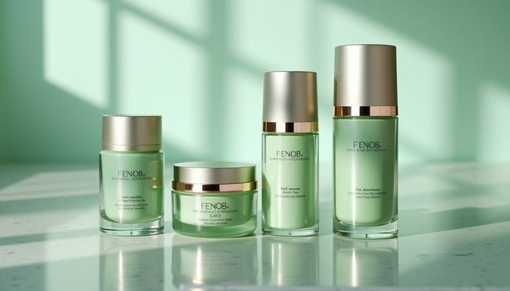
The Future of Beauty &
Healthcare in Morocco
Mipara represents the convergence of traditional pharmaceutical expertise with cutting-edge AI technology, creating a new standard for online health and beauty retail in Morocco.
As the $14M online pharmacy market grows 5-10% annually, Mipara is positioned at the forefront of digital healthcare innovation. With its unique AI diagnostic capability, authentic brand partnerships, and expert-guided approach, Mipara is not just selling products—it's delivering personalized wellness solutions and democratizing access to dermatological expertise.
AI-First
Authentic
Expert
Pioneering diagnostics
100% genuine products
Pharmacist-guided
Made with passion in Morocco
Mipara.ma

